Slide 1
Update: Piezo-energy harvesting
Chongan Wang
2024-11-22

Slide 2
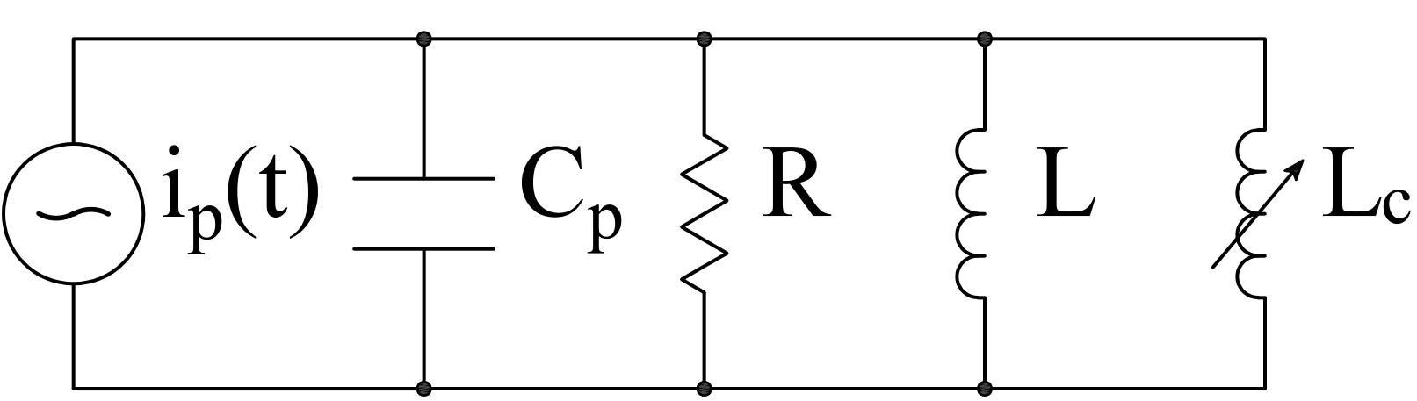
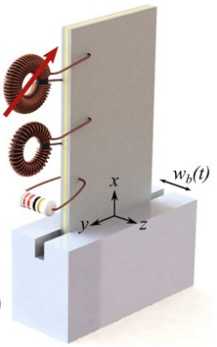

Schematic
$$v\left(t\right)$$
We consider two piezoelectric patches
A voltage signal is applied on the piezoelectric patch near the tip
The piezoelectric patches near the base is shunted by the following nonlinear circuit
Previous work in Obaidullah’s paper

Slide 3




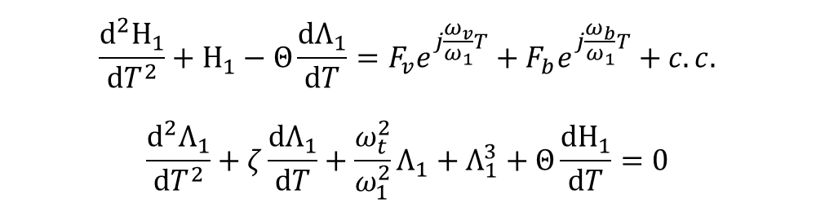
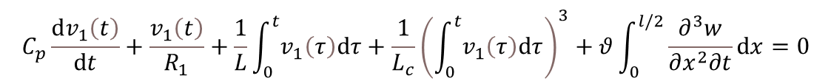
Analytical Foundation – a Review
$$−\frac{∂^{2}M}{∂x^{2}}+m\frac{∂^{2}w}{∂t^{2}}=0$$
$$x=l$$
Governing equations:
$$M=−YI\frac{∂^{2}w}{∂x^{2}}+θv_{1}\left(t\right)\left[H\left(x\right)−H\left(x−\frac{l}{2}\right)\right]+θv_{2}\left(t\right)\left[H\left(x−\frac{l}{2}\right)−H\left(x−l\right)\right]$$
$$v\left(t\right)$$
$$C_{p}\frac{dv_{1}\left(t\right)}{dt}+\frac{v_{1}\left(t\right)}{R_{1}}+\frac{1}{L}\int_{0}^{t}{v_{1}\left(τ\right)dτ}+\frac{1}{L_{c}}{\left(\int_{0}^{t}{v_{1}\left(τ\right)dτ}\right)}^{3}+θ\int_{0}^{l/2}{\frac{∂^{3}w}{∂x^{2}∂t}dx}=0$$
$$x=\frac{l}{2}$$
Normalized ROM
$$\frac{d^{2}Η_{1}}{dT^{2}}+Η_{1}−Θ\frac{dΛ_{1}}{dT}=F_{v}e^{j\frac{ω_{v}}{ω_{1}}T}+F_{b}e^{j\frac{ω_{b}}{ω_{1}}T}+c.c.$$
$$\frac{d^{2}Λ_{1}}{dT^{2}}+ζ\frac{dΛ_{1}}{dT}+\frac{ω_{t}^{2}}{ω_{1}^{2}}Λ_{1}+Λ_{1}^{3}+Θ\frac{dΗ_{1}}{dT}=0$$

Slide 4

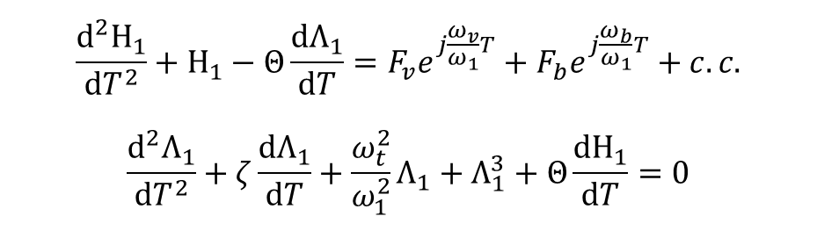




Hysteresis Loop and Responses
$$\frac{d^{2}Η_{1}}{dT^{2}}+Η_{1}−Θ\frac{dΛ_{1}}{dT}=F_{v}e^{j\frac{ω_{v}}{ω_{1}}T}+F_{b}e^{j\frac{ω_{b}}{ω_{1}}T}+c.c.$$
$$\frac{d^{2}Λ_{1}}{dT^{2}}+ζ\frac{dΛ_{1}}{dT}+\frac{ω_{t}^{2}}{ω_{1}^{2}}Λ_{1}+Λ_{1}^{3}+Θ\frac{dΗ_{1}}{dT}=0$$
$$2w_{0}=1μm$$
$$F_{b}=−0.0146$$
$$2v_{0}=1V$$
$$F_{v}=0.0052$$
Plot $\left(F_{v}e^{j\frac{ω_{v}−ω_{b}}{ω_{1}}T}+F_{b}\right)e^{j\frac{ω_{b}}{ω_{1}}T}+c.c.$ versus $T$

Slide 5
Topic in this Presentation
Why do we need to introduce nonlinearity – A comparison to linear systems
Power input/output

Slide 6
The flux linkage response to base excitation
$$\frac{d^{2}Η_{1}}{dT^{2}}+Η_{1}−Θ\frac{dΛ_{1}}{dT}=F_{v}e^{j\frac{ω_{v}}{ω_{1}}T}+F_{b}e^{j\frac{ω_{b}}{ω_{1}}T}+c.c.$$
$$\frac{d^{2}Λ_{1}}{dT^{2}}+ζ\frac{dΛ_{1}}{dT}+\frac{ω_{t}^{2}}{ω_{1}^{2}}Λ_{1}+Λ_{1}^{3}+Θ\frac{dΗ_{1}}{dT}=0$$
Simulations in the previous week
Hardening Nonlinear System
Linear System

Slide 7
The flux linkage response to base excitation
$$\frac{d^{2}Η_{1}}{dT^{2}}+Η_{1}−Θ\frac{dΛ_{1}}{dT}=F_{v}e^{j\frac{ω_{v}}{ω_{1}}T}+F_{b}e^{j\frac{ω_{b}}{ω_{1}}T}+c.c.$$
$$\frac{d^{2}Λ_{1}}{dT^{2}}+ζ\frac{dΛ_{1}}{dT}+\frac{ω_{t}^{2}}{ω_{1}^{2}}Λ_{1}+Λ_{1}^{3}+Θ\frac{dΗ_{1}}{dT}=0$$
Compared with linear systems, the following features are unique in nonlinear harvesters
The harvesting power is relatively stable, meaning that the power is insensitive to the fluctuation of stimuli compared with its linear counterpart
We can switch the on/off states
These features can be realized with other forms of nonlienarities.
Comment: In my perspective, the reason for more efficient energy harvesting is:
With the hardening nonlinearity, the frequency of the first mode shifts up, which is closer to the excitation frequency
It might be possible to design linear system with other inductance values to achieve such high harvesting power

Slide 8


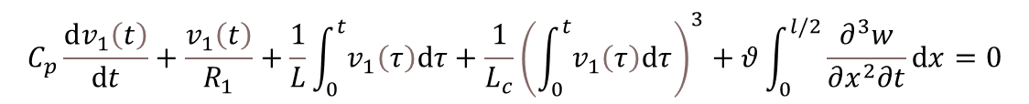
Power input
$$−\frac{∂^{2}M}{∂x^{2}}+m\frac{∂^{2}w}{∂t^{2}}=0$$
$$x=l$$
Structural equation
$$v\left(t\right)$$
$$M=−YI\frac{∂^{2}w}{∂x^{2}}+θv_{1}\left(t\right)\left[H\left(x\right)−H\left(x−\frac{l}{2}\right)\right]+θv_{2}\left(t\right)\left[H\left(x−\frac{l}{2}\right)−H\left(x−l\right)\right]$$
First circuit equation
$$x=\frac{l}{2}$$
$$C_{p}\frac{dv_{1}\left(t\right)}{dt}+\frac{v_{1}\left(t\right)}{R_{1}}+\frac{1}{L}\int_{0}^{t}{v_{1}\left(τ\right)dτ}+\frac{1}{L_{c}}{\left(\int_{0}^{t}{v_{1}\left(τ\right)dτ}\right)}^{3}+θ\int_{0}^{l/2}{\frac{∂^{3}w}{∂x^{2}∂t}dx}=0$$
Second circuit equation
$$C_{p}\frac{dv_{2}\left(t\right)}{dt}+θ\int_{0}^{l}{\frac{∂^{3}w}{∂x^{2}∂t}dx}=i_{2}\left(t\right)$$
The power of piezoelectric modulation is given by,
$$P_{2}\left(t\right)=v_{2}\left(t\right)i_{2}\left(t\right)$$

Slide 9
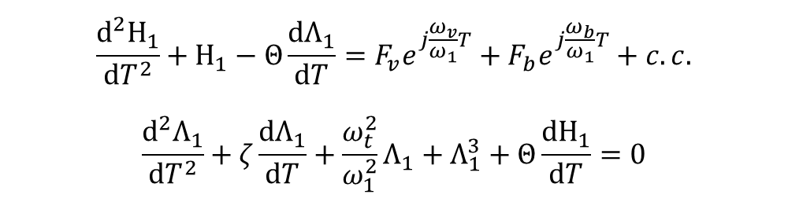

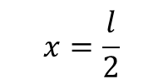
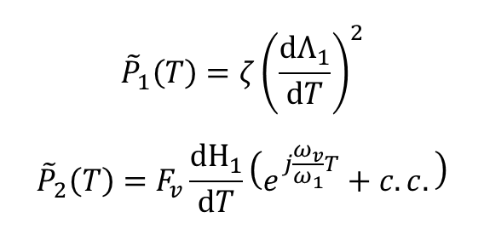

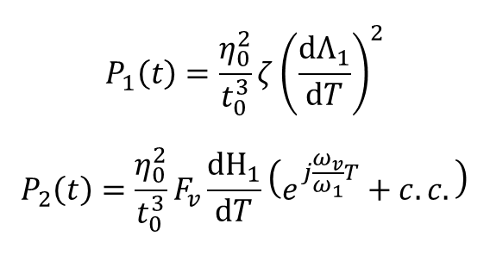
Power input in the ROM
$$x=l$$
$$v\left(t\right)$$
$$\frac{d^{2}Η_{1}}{dT^{2}}+Η_{1}−Θ\frac{dΛ_{1}}{dT}=F_{v}e^{j\frac{ω_{v}}{ω_{1}}T}+F_{b}e^{j\frac{ω_{b}}{ω_{1}}T}+c.c.$$
$$\frac{d^{2}Λ_{1}}{dT^{2}}+ζ\frac{dΛ_{1}}{dT}+\frac{ω_{t}^{2}}{ω_{1}^{2}}Λ_{1}+Λ_{1}^{3}+Θ\frac{dΗ_{1}}{dT}=0$$
$$x=\frac{l}{2}$$
In the normalized coordinate, the harvesting power and the modulation power is given by,
$$P_{1}\left(t\right)=\frac{η_{0}^{2}}{t_{0}^{3}}ζ{\left(\frac{dΛ_{1}}{dT}\right)}^{2}$$
$$P_{2}\left(t\right)=\frac{η_{0}^{2}}{t_{0}^{3}}F_{v}\frac{dΗ_{1}}{dT}\left(e^{j\frac{ω_{v}}{ω_{1}}T}+c.c.\right)$$
$${\tilde{P}}_{1}\left(T\right)=ζ{\left(\frac{dΛ_{1}}{dT}\right)}^{2}$$
$${\tilde{P}}_{2}\left(T\right)=F_{v}\frac{dΗ_{1}}{dT}\left(e^{j\frac{ω_{v}}{ω_{1}}T}+c.c.\right)$$
normalization
Ideally, the power flow can be computed analytically from the theoretical results. But here I only demonstrate numerical simulations

Slide 10
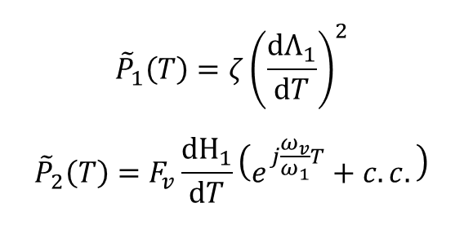
Power input in the ROM
$${\tilde{P}}_{1}\left(T\right)=ζ{\left(\frac{dΛ_{1}}{dT}\right)}^{2}$$
$${\tilde{P}}_{2}\left(T\right)=F_{v}\frac{dΗ_{1}}{dT}\left(e^{j\frac{ω_{v}}{ω_{1}}T}+c.c.\right)$$
We plot the normalized energy of the previous simulations over time

Slide 11
Proposed Next Stage
Develop MATLAB codes for continuous simulations to confirm the ROM
Increasing the modulation frequency
Embrace random terms (white noise) in the ambient vibration

Slide 12

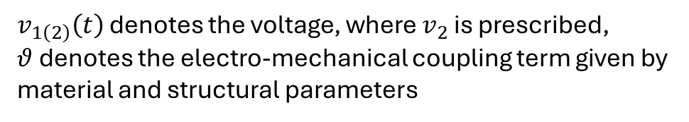
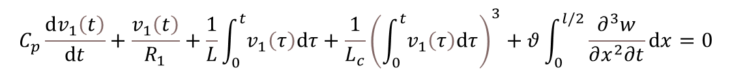
EOM
$$x=l$$
Bending moment
$$M=−YI\frac{∂^{2}w}{∂x^{2}}+θv_{1}\left(t\right)\left[H\left(x\right)−H\left(x−\frac{l}{2}\right)\right]+θv_{2}\left(t\right)\left[H\left(x−\frac{l}{2}\right)−H\left(x−l\right)\right]$$
$$v\left(t\right)$$
Neglect structural damping
$$−\frac{∂^{2}M}{∂x^{2}}+m\frac{∂^{2}w}{∂t^{2}}=0$$
$$x=\frac{l}{2}$$
Circuit equation
$$C_{p}\frac{dv_{1}\left(t\right)}{dt}+\frac{v_{1}\left(t\right)}{R_{1}}+\frac{1}{L}\int_{0}^{t}{v_{1}\left(τ\right)dτ}+\frac{1}{L_{c}}{\left(\int_{0}^{t}{v_{1}\left(τ\right)dτ}\right)}^{3}+θ\int_{0}^{l/2}{\frac{∂^{3}w}{∂x^{2}∂t}dx}=0$$
$v_{1\left(2\right)}\left(t\right)$ denotes the voltage, where $v_{2}$ is prescribed,
$θ$ denotes the electro-mechanical coupling term given by material and structural parameters
$$w=w_{b}\left(t\right)+w_{rel}\left(x,t\right)$$
Base excitation
Relative displacement

Slide 13
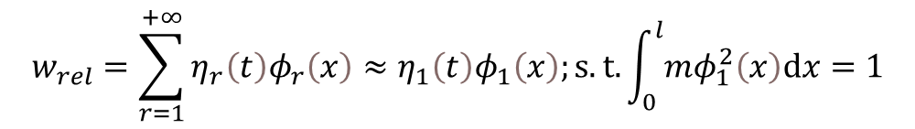
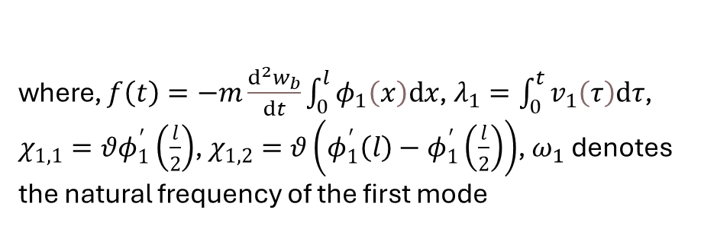
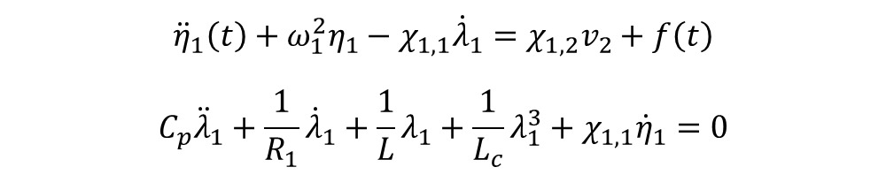
ROM
$$w=w_{b}\left(t\right)+w_{rel}\left(x,t\right)$$
$$x=l$$
We assume that the beam deflection is approximated by the first mode of a cantilever beam,
$$v\left(t\right)$$
$$w_{rel}=\sum_{r=1}^{+∞}{η_{r}\left(t\right)φ_{r}\left(x\right)}≈η_{1}\left(t\right)φ_{1}\left(x\right);s.t.\int_{0}^{l}{mφ_{1}^{2}\left(x\right)dx}=1$$
$$x=\frac{l}{2}$$
ROM equation,
$${\ddot{η}}_{1}\left(t\right)+ω_{1}^{2}η_{1}−χ_{1,1}{\dot{λ}}_{1}=χ_{1,2}v_{2}+f\left(t\right)$$
$$C_{p}{\ddot{λ}}_{1}+\frac{1}{R_{1}}{\dot{λ}}_{1}+\frac{1}{L}λ_{1}+\frac{1}{L_{c}}λ_{1}^{3}+χ_{1,1}{\dot{η}}_{1}=0$$
where, $f\left(t\right)=−m\frac{d^{2}w_{b}}{dt}\int_{0}^{l}{φ_{1}\left(x\right)dx}$, $λ_{1}=\int_{0}^{t}{v_{1}\left(τ\right)dτ}$, $χ_{1,1}=θφ_{1}^{′}\left(\frac{l}{2}\right)$, $χ_{1,2}=θ\left(φ_{1}^{′}\left(l\right)−φ_{1}^{′}\left(\frac{l}{2}\right)\right)$, $ω_{1}$ denotes the natural frequency of the first mode

Slide 14
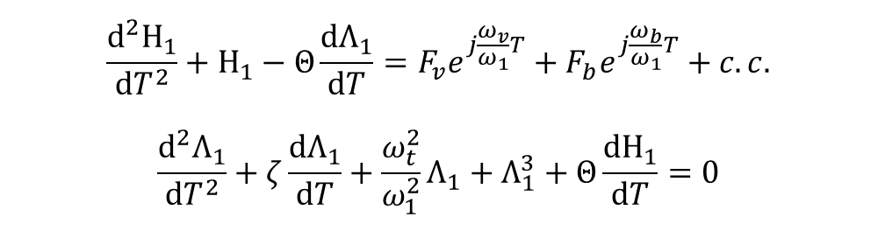

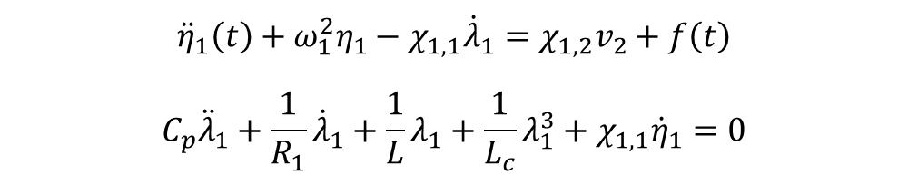



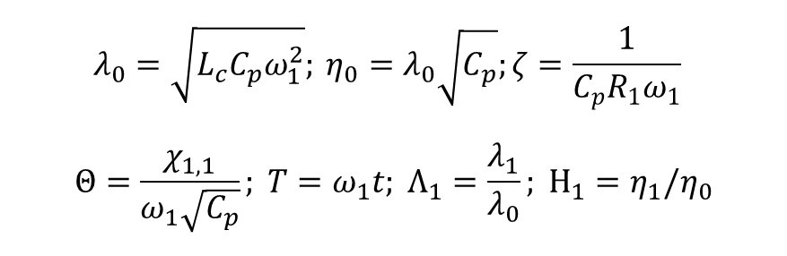
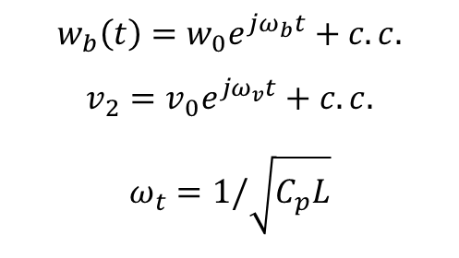
Normalized ROM
$$x=l$$
$$v\left(t\right)$$
$$F_{b}=\frac{mω_{b}^{2}w_{0}\int_{0}^{l}{φ_{1}\left(x\right)dx}}{ω_{1}^{2}η_{0}}$$
$$F_{v}=Θ\frac{χ_{1,2}v_{0}}{χ_{1,1}ω_{1}λ_{0}}$$
$${\ddot{η}}_{1}\left(t\right)+ω_{1}^{2}η_{1}−χ_{1,1}{\dot{λ}}_{1}=χ_{1,2}v_{2}+f\left(t\right)$$
$$C_{p}{\ddot{λ}}_{1}+\frac{1}{R_{1}}{\dot{λ}}_{1}+\frac{1}{L}λ_{1}+\frac{1}{L_{c}}λ_{1}^{3}+χ_{1,1}{\dot{η}}_{1}=0$$
$$x=\frac{l}{2}$$
$$w_{b}\left(t\right)=w_{0}e^{jω_{b}t}+c.c.$$
$$v_{2}=v_{0}e^{jω_{v}t}+c.c.$$
$$ω_{t}=1/\sqrt{C_{p}L}$$
$$λ_{0}=\sqrt{L_{c}C_{p}ω_{1}^{2}}; η_{0}=λ_{0}\sqrt{C_{p}};ζ=\frac{1}{C_{p}R_{1}ω_{1}}$$
$$Θ=\frac{χ_{1,1}}{ω_{1}\sqrt{C_{p}}}; T=ω_{1}t; Λ_{1}=\frac{λ_{1}}{λ_{0}}; Η_{1}=η_{1}/η_{0}$$
$$\frac{d^{2}Η_{1}}{dT^{2}}+Η_{1}−Θ\frac{dΛ_{1}}{dT}=F_{v}e^{j\frac{ω_{v}}{ω_{1}}T}+F_{b}e^{j\frac{ω_{b}}{ω_{1}}T}+c.c.$$
$$\frac{d^{2}Λ_{1}}{dT^{2}}+ζ\frac{dΛ_{1}}{dT}+\frac{ω_{t}^{2}}{ω_{1}^{2}}Λ_{1}+Λ_{1}^{3}+Θ\frac{dΗ_{1}}{dT}=0$$

Slide 15

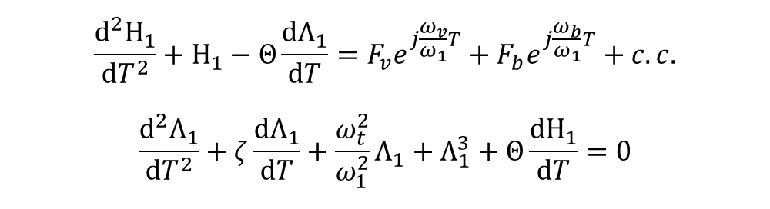


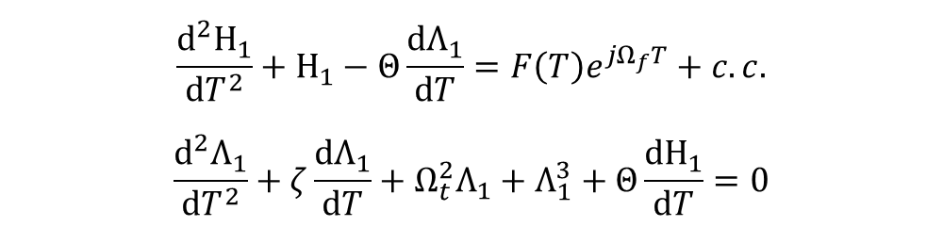
Normalized ROM
$$x=l$$
$$v\left(t\right)$$
$$\frac{d^{2}Η_{1}}{dT^{2}}+Η_{1}−Θ\frac{dΛ_{1}}{dT}=F_{v}e^{j\frac{ω_{v}}{ω_{1}}T}+F_{b}e^{j\frac{ω_{b}}{ω_{1}}T}+c.c.$$
$$\frac{d^{2}Λ_{1}}{dT^{2}}+ζ\frac{dΛ_{1}}{dT}+\frac{ω_{t}^{2}}{ω_{1}^{2}}Λ_{1}+Λ_{1}^{3}+Θ\frac{dΗ_{1}}{dT}=0$$
$$x=\frac{l}{2}$$
Quasi-periodic excitation:
$$F_{v}e^{j\frac{ω_{v}}{ω_{1}}T}+F_{b}e^{j\frac{ω_{b}}{ω_{1}}T}=\left(F_{v}e^{j\frac{ω_{v}−ω_{b}}{ω_{1}}T}+F_{b}\right)e^{j\frac{ω_{b}}{ω_{1}}T}$$
In the analysis, we assume that $F_{v}e^{j\frac{ω_{v}−ω_{b}}{ω_{1}}T}+F_{b}$ is a slowly-varying term.
$$\frac{ω_{b}}{ω_{1}}=Ω_{f}$$
$$\frac{d^{2}Η_{1}}{dT^{2}}+Η_{1}−Θ\frac{dΛ_{1}}{dT}=F\left(T\right)e^{jΩ_{f}T}+c.c.$$
$$\frac{d^{2}Λ_{1}}{dT^{2}}+ζ\frac{dΛ_{1}}{dT}+Ω_{t}^{2}Λ_{1}+Λ_{1}^{3}+Θ\frac{dΗ_{1}}{dT}=0$$
$$\frac{ω_{t}^{2}}{ω_{1}^{2}}=Ω_{t}^{2}$$

Slide 16

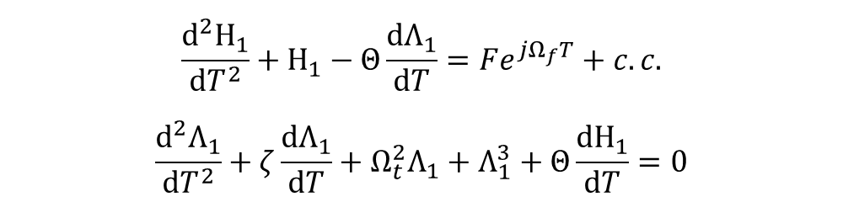

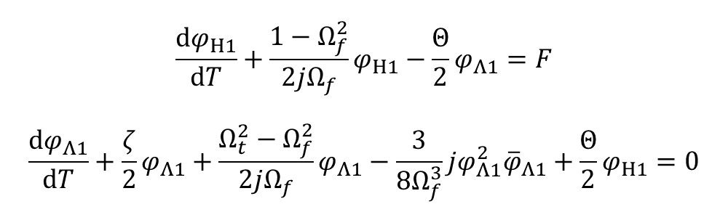
CX-A
$$x=l$$
$$v\left(t\right)$$
$$\frac{d^{2}Η_{1}}{dT^{2}}+Η_{1}−Θ\frac{dΛ_{1}}{dT}=Fe^{jΩ_{f}T}+c.c.$$
$$\frac{d^{2}Λ_{1}}{dT^{2}}+ζ\frac{dΛ_{1}}{dT}+Ω_{t}^{2}Λ_{1}+Λ_{1}^{3}+Θ\frac{dΗ_{1}}{dT}=0$$
$$x=\frac{l}{2}$$
Ansatz:
$$ψ_{Η1}=\frac{dΗ_{1}}{dT}+jΩ_{f}Η_{1}=φ_{Η1}e^{jΩ_{f}T}$$
$$ψ_{Λ1}=\frac{dΛ_{1}}{dT}+jΩ_{f}Λ_{1}=φ_{Λ1}e^{jΩ_{f}T}$$
Average out $e^{jΩ_{f}T}$terms:
$$\frac{dφ_{Η1}}{dT}+\frac{1−Ω_{f}^{2}}{2jΩ_{f}}φ_{Η1}−\frac{Θ}{2}φ_{Λ1}=F$$
$$\frac{dφ_{Λ1}}{dT}+\frac{ζ}{2}φ_{Λ1}+\frac{Ω_{t}^{2}−Ω_{f}^{2}}{2jΩ_{f}}φ_{Λ1}−\frac{3}{8Ω_{f}^{3}}jφ_{Λ1}^{2}{\overline{φ}}_{Λ1}+\frac{Θ}{2}φ_{Η1}=0$$

Slide 17

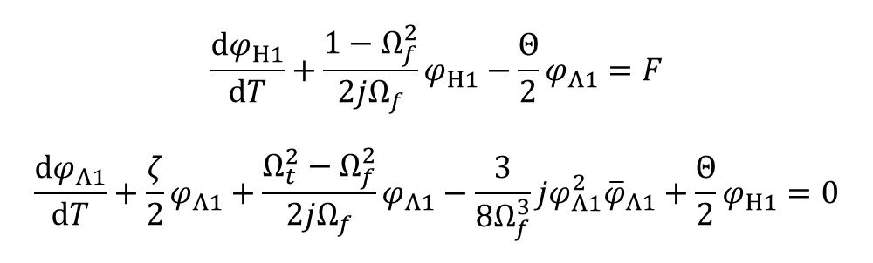
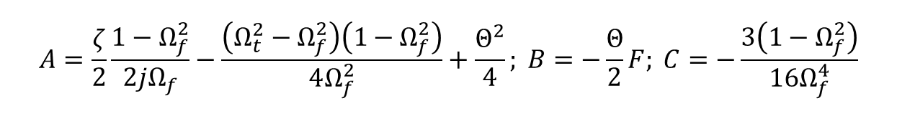
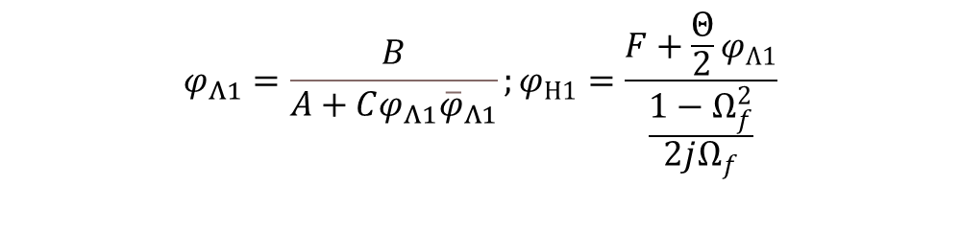
Steady-state
$$x=l$$
$$v\left(t\right)$$
$$\frac{dφ_{Η1}}{dT}+\frac{1−Ω_{f}^{2}}{2jΩ_{f}}φ_{Η1}−\frac{Θ}{2}φ_{Λ1}=F$$
$$\frac{dφ_{Λ1}}{dT}+\frac{ζ}{2}φ_{Λ1}+\frac{Ω_{t}^{2}−Ω_{f}^{2}}{2jΩ_{f}}φ_{Λ1}−\frac{3}{8Ω_{f}^{3}}jφ_{Λ1}^{2}{\overline{φ}}_{Λ1}+\frac{Θ}{2}φ_{Η1}=0$$
$$x=\frac{l}{2}$$
$$\frac{dφ_{Η1}}{dT}=\frac{dφ_{Λ1}}{dT}=0$$
$$C^{2}{\left(φ_{Λ1}{\overline{φ}}_{Λ1}\right)}^{3}+\left(A+\overline{A}\right)C{\left(φ_{Λ1}{\overline{φ}}_{Λ1}\right)}^{2}+A\overline{A}φ_{Λ1}{\overline{φ}}_{Λ1}=B\overline{B}$$
$$φ_{Λ1}=\frac{B}{A+Cφ_{Λ1}{\overline{φ}}_{Λ1}};φ_{Η1}=\frac{F+\frac{Θ}{2}φ_{Λ1}}{\frac{1−Ω_{f}^{2}}{2jΩ_{f}}}$$
$$A=\frac{ζ}{2}\frac{1−Ω_{f}^{2}}{2jΩ_{f}}−\frac{\left(Ω_{t}^{2}−Ω_{f}^{2}\right)\left(1−Ω_{f}^{2}\right)}{4Ω_{f}^{2}}+\frac{Θ^{2}}{4}; B=−\frac{Θ}{2}F; C=−\frac{3\left(1−Ω_{f}^{2}\right)}{16Ω_{f}^{4}}$$

Slide 18

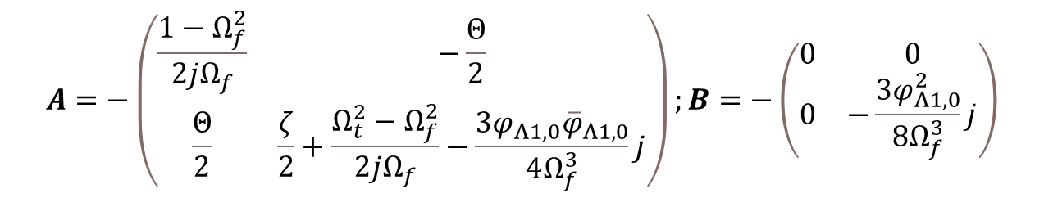

Stability analysis
$$x=l$$
$$v\left(t\right)$$
$$\frac{dφ_{Η1}}{dT}+\frac{1−Ω_{f}^{2}}{2jΩ_{f}}φ_{Η1}−\frac{Θ}{2}φ_{Λ1}=F$$
$$\frac{dφ_{Λ1}}{dT}+\frac{ζ}{2}φ_{Λ1}+\frac{Ω_{t}^{2}−Ω_{f}^{2}}{2jΩ_{f}}φ_{Λ1}−\frac{3}{8Ω_{f}^{3}}jφ_{Λ1}^{2}{\overline{φ}}_{Λ1}+\frac{Θ}{2}φ_{Η1}=0$$
$$x=\frac{l}{2}$$
$$φ_{Η1}=φ_{Η1,0}+φ_{Η1}$$
$$φ_{Λ1}=φ_{Λ1,0}+φ_{Λ1}$$
$$\frac{d}{dT}\left(\begin{matrix}φ_{Η1} \\ φ_{Λ1}\end{matrix}\right)=A\left(\begin{matrix}φ_{Η1} \\ φ_{Λ1}\end{matrix}\right)+B\left(\begin{matrix}{\overline{φ}}_{Η1} \\ {\overline{φ}}_{Λ1}\end{matrix}\right)$$
Real parts of the eigenvalue of the matrix $\left(\begin{matrix}A & B \\ \overline{B} & \overline{A}\end{matrix}\right)$ are negative
$$A=−\left(\begin{matrix}\frac{1−Ω_{f}^{2}}{2jΩ_{f}} & −\frac{Θ}{2} \\ \frac{Θ}{2} & \frac{ζ}{2}+\frac{Ω_{t}^{2}−Ω_{f}^{2}}{2jΩ_{f}}−\frac{3φ_{Λ1,0}{\overline{φ}}_{Λ1,0}}{4Ω_{f}^{3}}j\end{matrix}\right);B=−\left(\begin{matrix}0 & 0 \\ 0 & −\frac{3φ_{Λ1,0}^{2}}{8Ω_{f}^{3}}j\end{matrix}\right)$$

